Slide 1
Evolution of O.S
1. Simple batch system
2. Multiprogramming batch system
3. Multiprocessor system/parallel system
4. Desktop systems / personal computer
5. Distrubuted o.s
6. Clustered systems.
7. Timesharing systems
8. Real time systems
9. Handheld systems

Slide 2
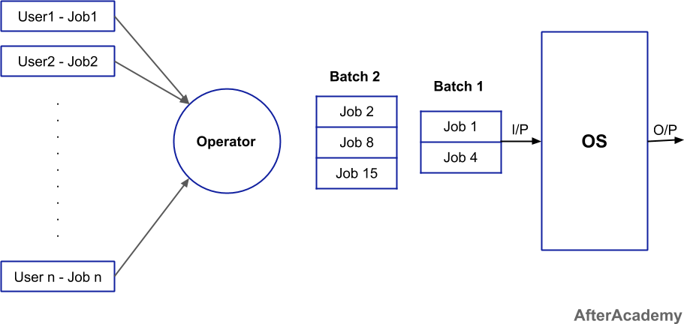
Simple batch system
There is no direct interaction b/w user and computer
The user has to submit a job to a computer operator
Based on the similarity operator creates the batches
operator places the job on input device
Special program available in main memory which manages the execution of each program in the batch.
until the batch 1 completed batch 2 is wait

Slide 3
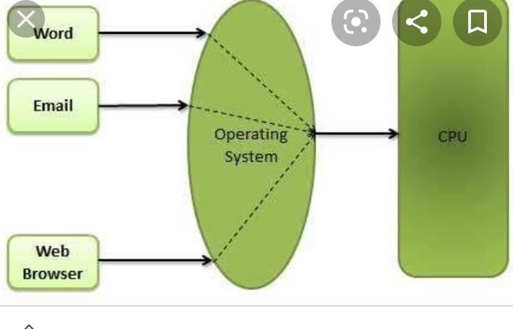
Multiprogramming batch system
In this os picks one job and begins execution
while executing the job requires any reource os stops execution and switch the other job
If several jobs are ready for execution os select one process through CPU using scheduling algorithms.
In multiprogramming CPU never be idle

Slide 4
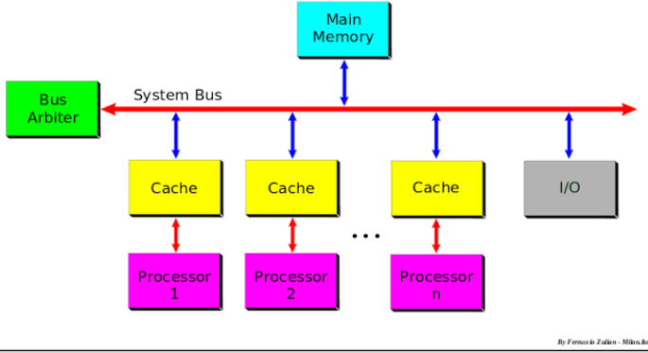
Multiprocessor system/Parallel system
In multiprocessor system consists of several processors that share a common physical memory
speed of the system is very high
In this all processors operate under single o.s
If any one of the processor fail automatically job executed by another processor.
Execution of several tasks by different processors concurrently
If possible system divides task into many subtask and then these subtasks can be executed in parallel in different processors

Slide 5
Desktop systems or Personal computer
os designed for user convenience
easy to use of the computer
Good performance instead of utilizing resources

Slide 6
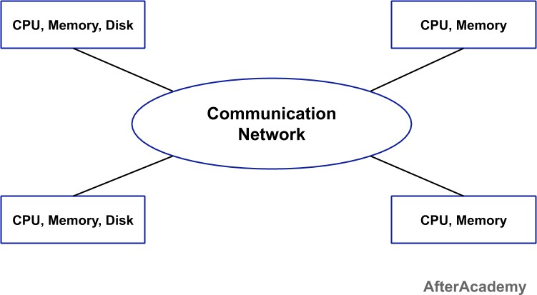
Distributed OS
This system consists of many computers that are interconnectd by communication n/w
users at one site can utilize the resources of system at other sites.
fast processing
Two types of distributed os.
client-server systems
Peer-to-peer systems

Slide 7
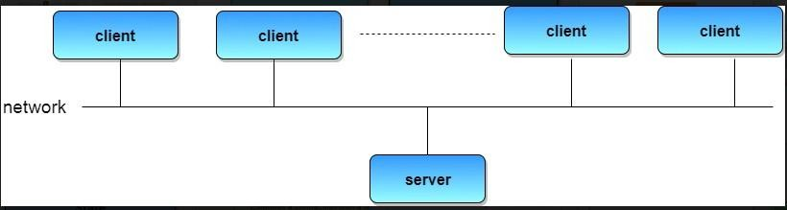
Client server systems:
Centralize system act as server systems to satisfy request generated by client systems.
server system can by categorized as
1.computer server
2.file server
computer server system provides an
interface to which client sends request
to perform an action, in response execute the
action and send back results to the client

Slide 8

File server system provides a file system interface where client can create,update,delete and read files.
Peer to peer systems:
In this system every system act as client and server
os allows users to share resources and file located on their computers.
all computers are considered equally.

Slide 9
Clustered system:
Clustered system is composed of 2 or more individual systems joined together.
share the common storage and closely linked through LAN.
individual computers are called as node.
each node works on its own o.s
share the h/w devices
advantage of clustering is high availability.
work will not stop if one node fails
each node have the cluster s/w
with the help of cluster s/w each node can monitor the other node in n/w

Slide 10
if any node fail other system gets the information
if any node is free take that failure node task and complete it.
Types of clustering:
1.parallel clustering
2.Asymmetric clustering
3.Symmetric clustering
parallel clustering: multiple nodes can access the same data on same shared storage.

Slide 11
Asymmetric clustering:
Here one node is act as an hot stand by mode and reaminig all running the applications
this node monitor each node present in the n/w
if any node failure it takes the failure node task and complete it.
Symmetric clustering:
no node ia na hot stand by mode
node A monitors B & c
Here every node is used for computation(running applications)
more efficient than the Asymmetric cluster.

Slide 12
Real time os: process should be executed within the time limit.
hard real time os: execution of process exceeds the time limit. it leads
critical failure
soft real time os: it may accept few delays.
Time sharing os: cpu allocates the some amount of time for each process to execute.
Handheld systems: cellphones with internet. they are usually limited size,small amount of memory,slow processor,small display screen.
advantage scanning the bar codes.

Slide 13
Sr.No. | Multiprocessing or parallel operating system | Multiprogramming
1 | Execution of mulitiple processes by multiple cpu’s at a time | Execution of multiple programs by single cpu at a time
2 | It utilizes multiple CPUs. | It utilizes a single CPU.
3 | It permits parallel processing. | Context switching takes place.
4 | Less time taken to process the jobs. | MoreTime taken to process thejobs.
5 | all devices are utilized very efficiently | Less efficient than multiprocessing.
6 | Usually more expensive. | Such systems are less expensive.

Slide 14
Sr.No. | RealTimeSystem | TimesharingSystem
1 | Process should be completed with in the time limit | In this system, many users are simultaneously share thecomputer resources.
2 | it deals with only one application. | it deals with many applications
4 | Users must get a response within thespecified time limit; otherwise it mayresul tin a disaster. | Users should get a response within fractions of seconds but if not, the results are not disastrous.
5 | No context switching | Context switching

